Slide 1
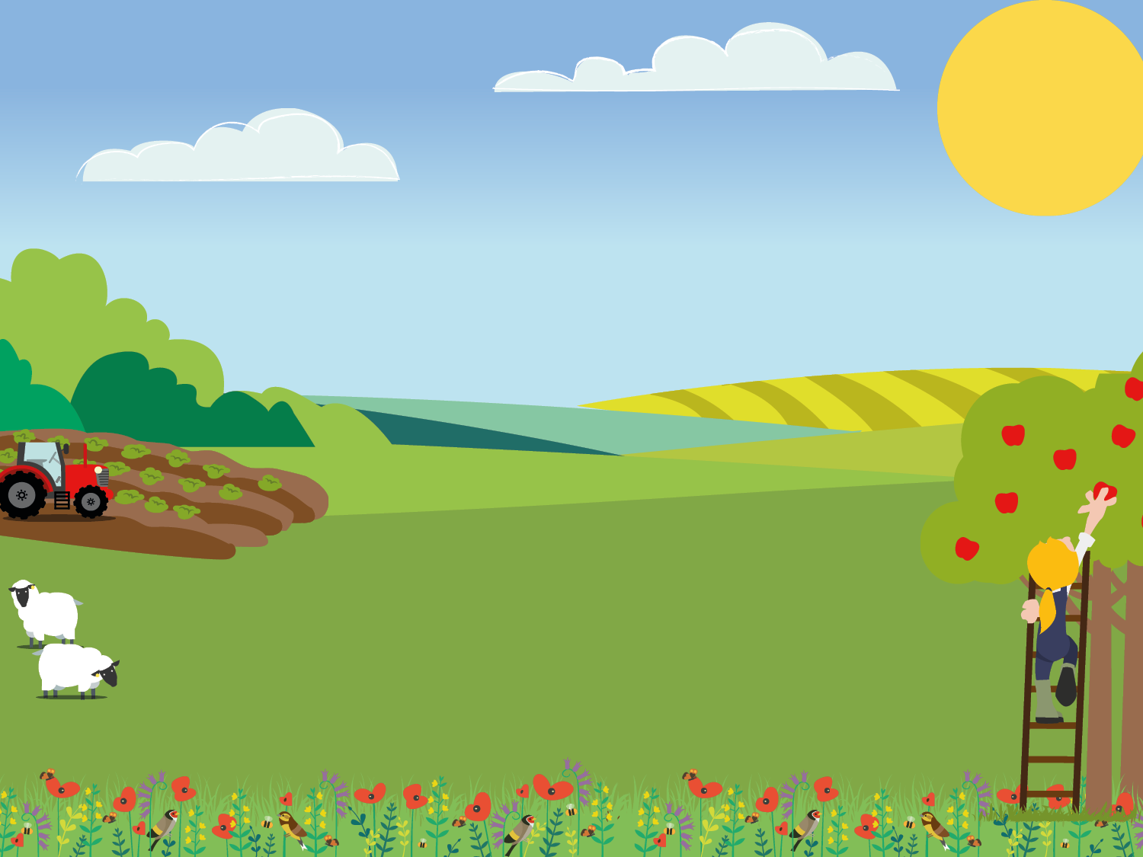

Stage 1: Designing a business logo

Slide 2

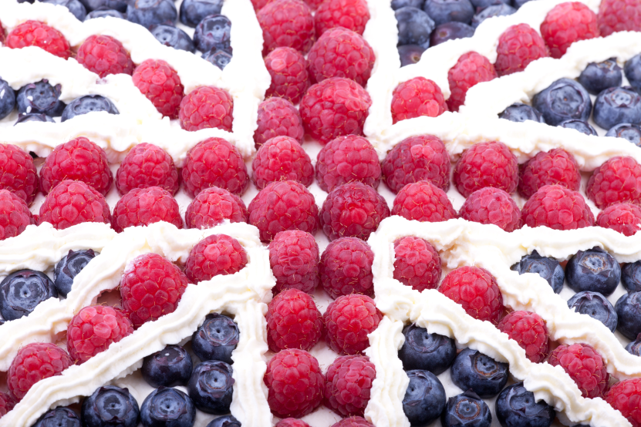
The Challenge!
Your challenge is to work in groups to set up your very own yoghurt café!
Through this project you will design and make your own British flag yoghurt dishes to sell in your café.

Slide 3

Work in your groups to think of a name for your yoghurt café business.

Slide 4
What is the name of this shape?
How many edges does it have?
How many corners does it have?
Can you find some examples in the classroom?

Slide 5
What is the name of this shape?
How many edges does it have?
How many corners does it have?
Can you find some examples in the classroom?

Slide 6
What is the name of this shape?
How many edges does it have?
How many corners does it have?
Can you find some examples in the classroom?

Slide 7
What is the name of this shape?
How many edges does it have?
How many corners does it have?
Can you find some examples in the classroom?

Slide 8
Use your 2D shape learning to design a logo for your yoghurt café business.
the
Yoghurt
café

